Slide 1
Perioperative Anaphylaxis Management Guidelines
Australian and New Zealand College of Anaesthetists (ANZCA)
and
Australian and New Zealand Anaesthetic Allergy Group (ANZAAG)

Slide 2
INTRODUCTON
Anaphylaxis is a life-threatening emergency that requires prompt recognition of signs and symptoms, early administration of adrenaline (epinephrine) in adequate dosage, and aggressive volume replacement.

Slide 3
INTRODUCTON
Management of anaphylaxis consists of prompt diagnosis, immediate treatment, refractory management, and post crisis management.

Slide 4
DIAGNOSIS OF ANAPHYLAXIS
Early recognition and prompt management of anaphylaxis is essential.
Anaphylaxis should be considered if skin signs co-exist with bronchospasm or hypotension.
Hypotension or tachycardia alone, especially where this is unresponsive to vasopressors or is unanticipated should raise suspicion.
Bradycardia may also be a presenting sign of anaphylaxis.

Slide 5
DIAGNOSIS OF ANAPHYLAXIS
Bronchospasm or difficulty with ventilation may be a feature of anaphylaxis or the sole presenting feature in some cases.
The absence of skin signs does not rule out the diagnosis, as skin signs may not appear until circulation is restored.

Slide 6
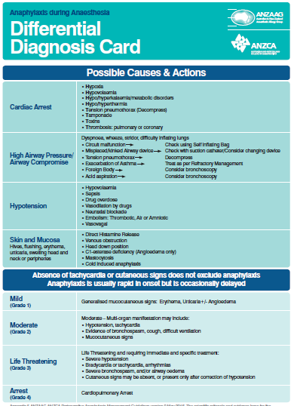

Slide 7
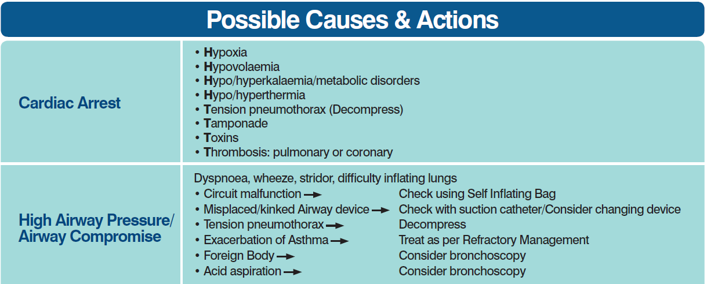

Slide 8
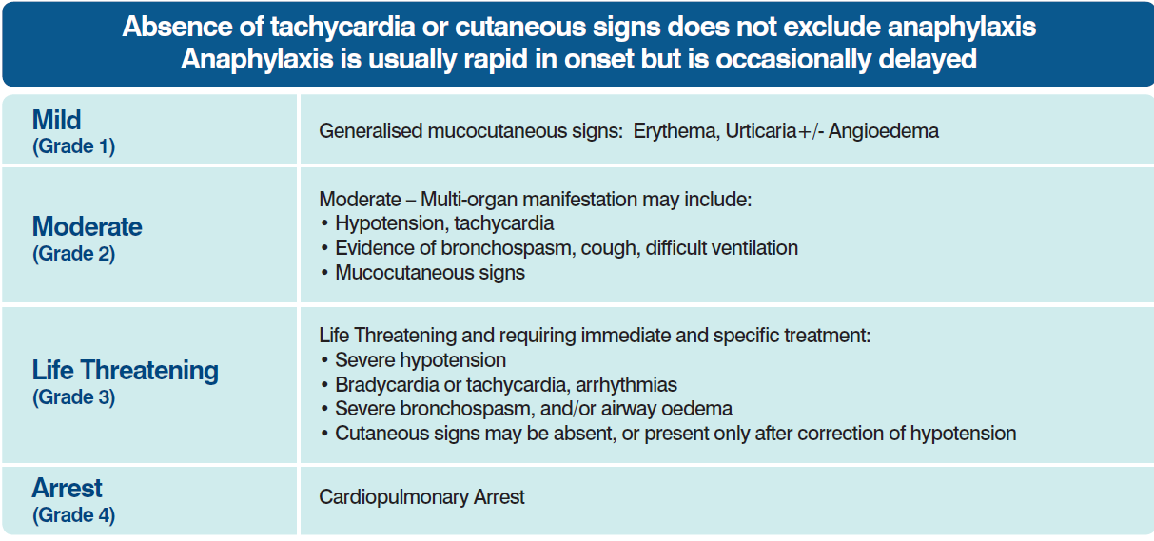

Slide 9
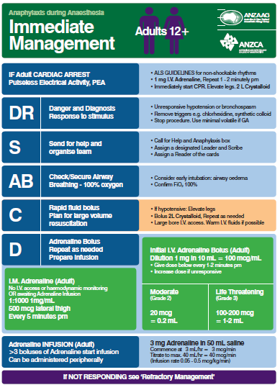

Slide 10
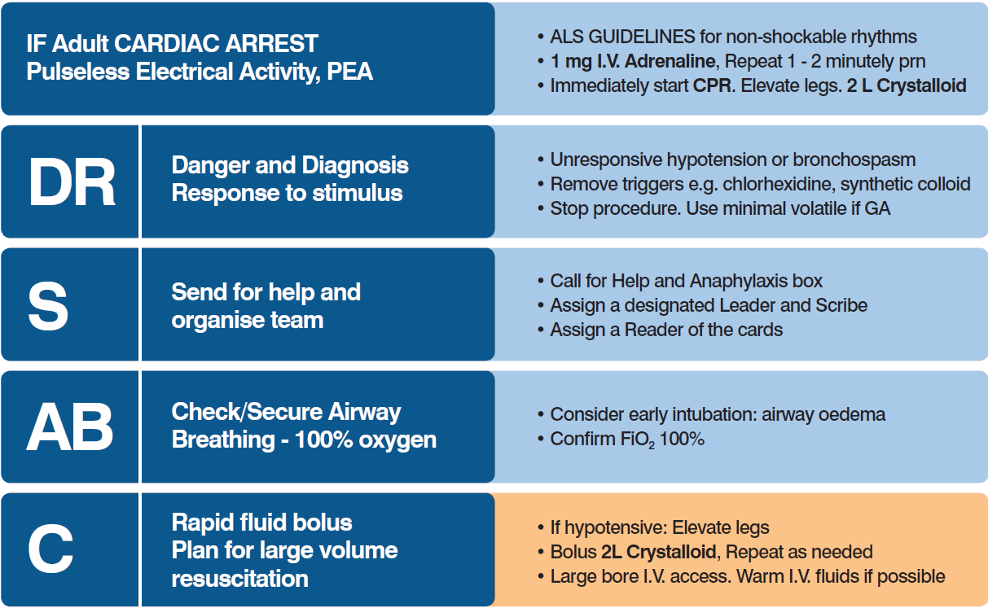

Slide 11
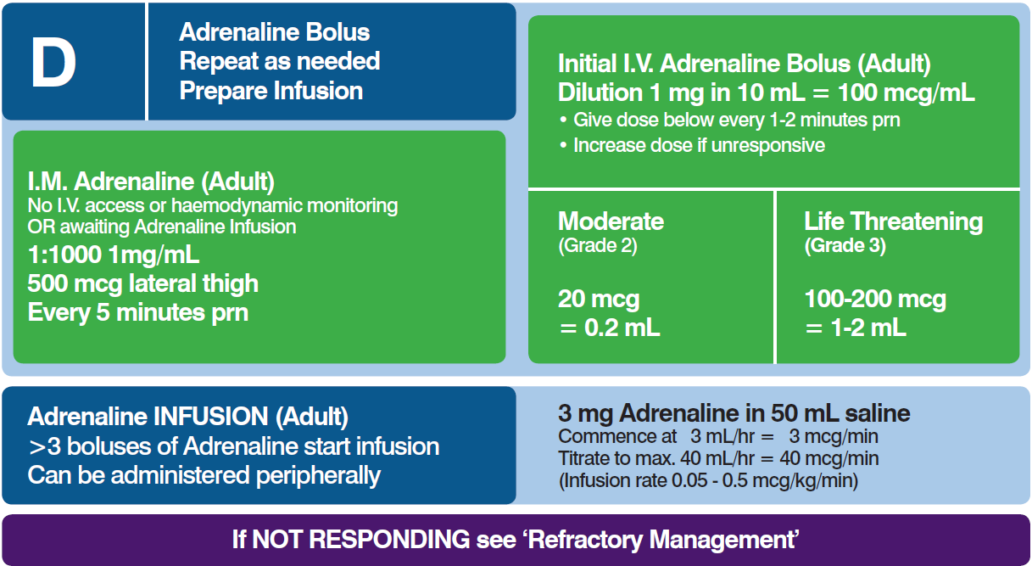

Slide 12
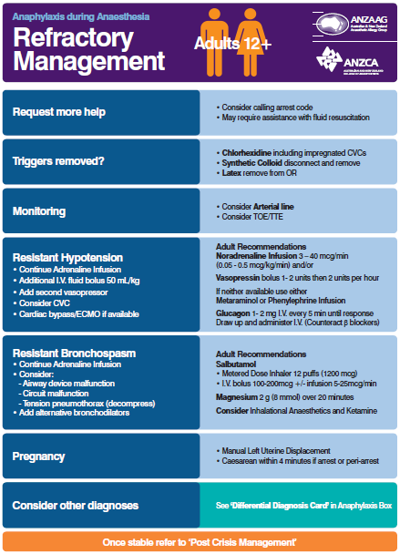

Slide 13
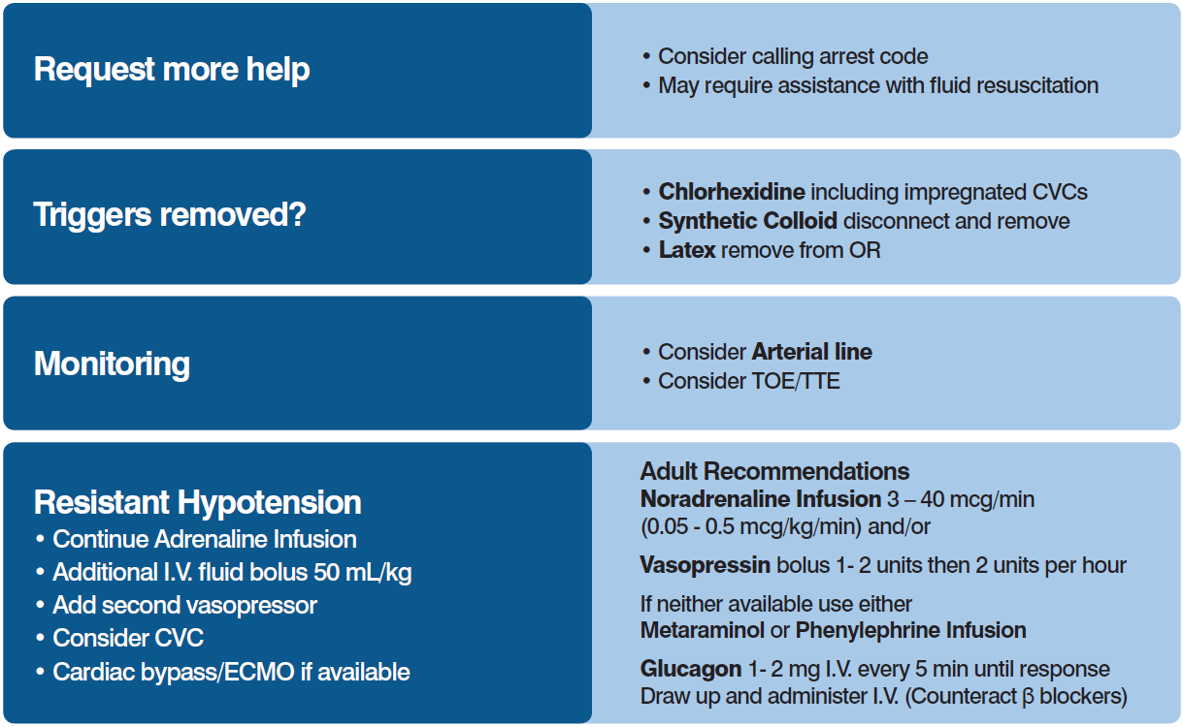

Slide 14
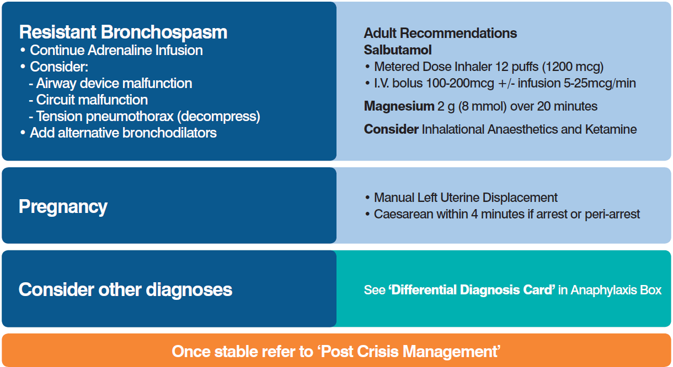

Slide 15
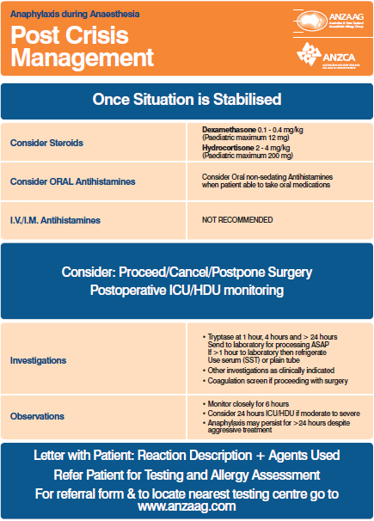

Slide 16
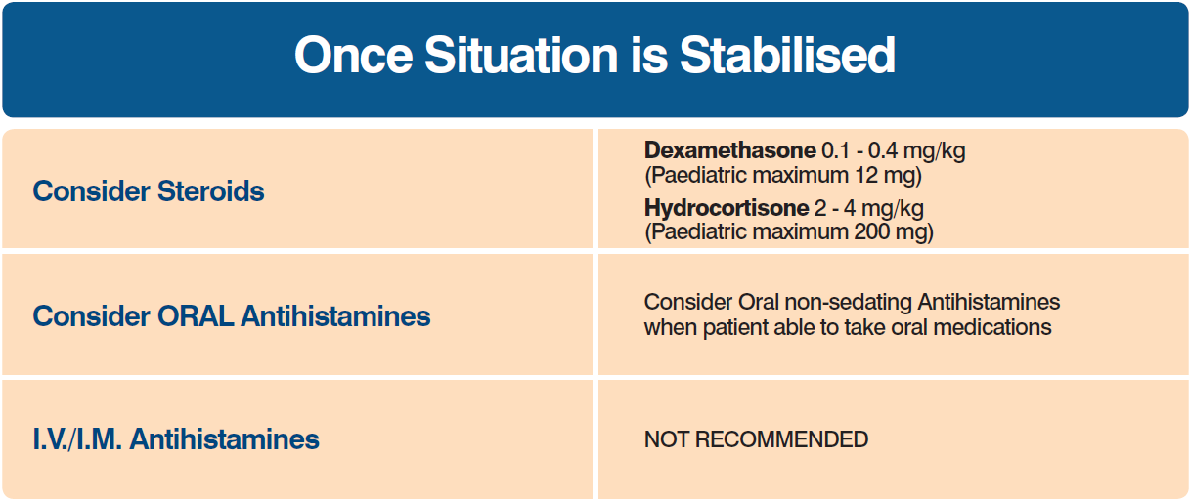

Slide 18
จบบริบูรณ์
อวสาน

